Slide 1

Matching Co-Founders
A Ml Approach to the problem
Ali Cihan Isikal

Slide 2

Alright, you need a co-founder. But who?
-Someone wıth superıor buıldıng skılls?
-someone great at marketıng&sellıng and a great communıcator?

Slide 3

Optimal scenario for a co-founder
1. A complementary character.
2. Different operational skills
3. Similar work habits.
4. Self-sufficiency.
Source: hbr.org/2011/02/how-to-pick-a-co-founder

Slide 4

Alright, we have a roadmap.
-Potential co-founders could be people who share same values and motivations.
-And who share different complimentary skills, which is needed to build a robust company.

Slide 5

Let’s try to build ML Model that can help us for this problem.

Slide 6

How ML pipeline generally works
-Gathering data
-Preprocess the data for your specific purpose
-Train
-Test
-Deploy the model

Slide 7

Data we need
Entrepreneurs with successful/unsuccesful ventures.
Their: Skills, experiences, values, motivation.
Resource: LinkedIn profiles, Y Combinator Dataset
(Thanks for the advice of course!)

Slide 8

Preprocessing the dataset
-Clearing, gathering, combining data

Slide 9

Approaches to the problem
-Collaboratıve fılterıng
-clusterıng
-Cosine similarity
-Neural networks

Slide 10

Failing is some part of learning (maybe more for a beginner like me ☺)

Slide 11
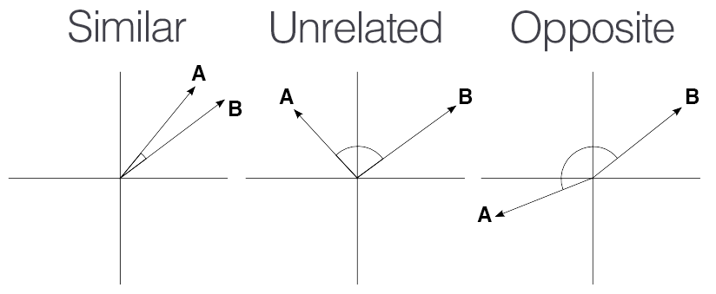
Cosine Similarity

Slide 12
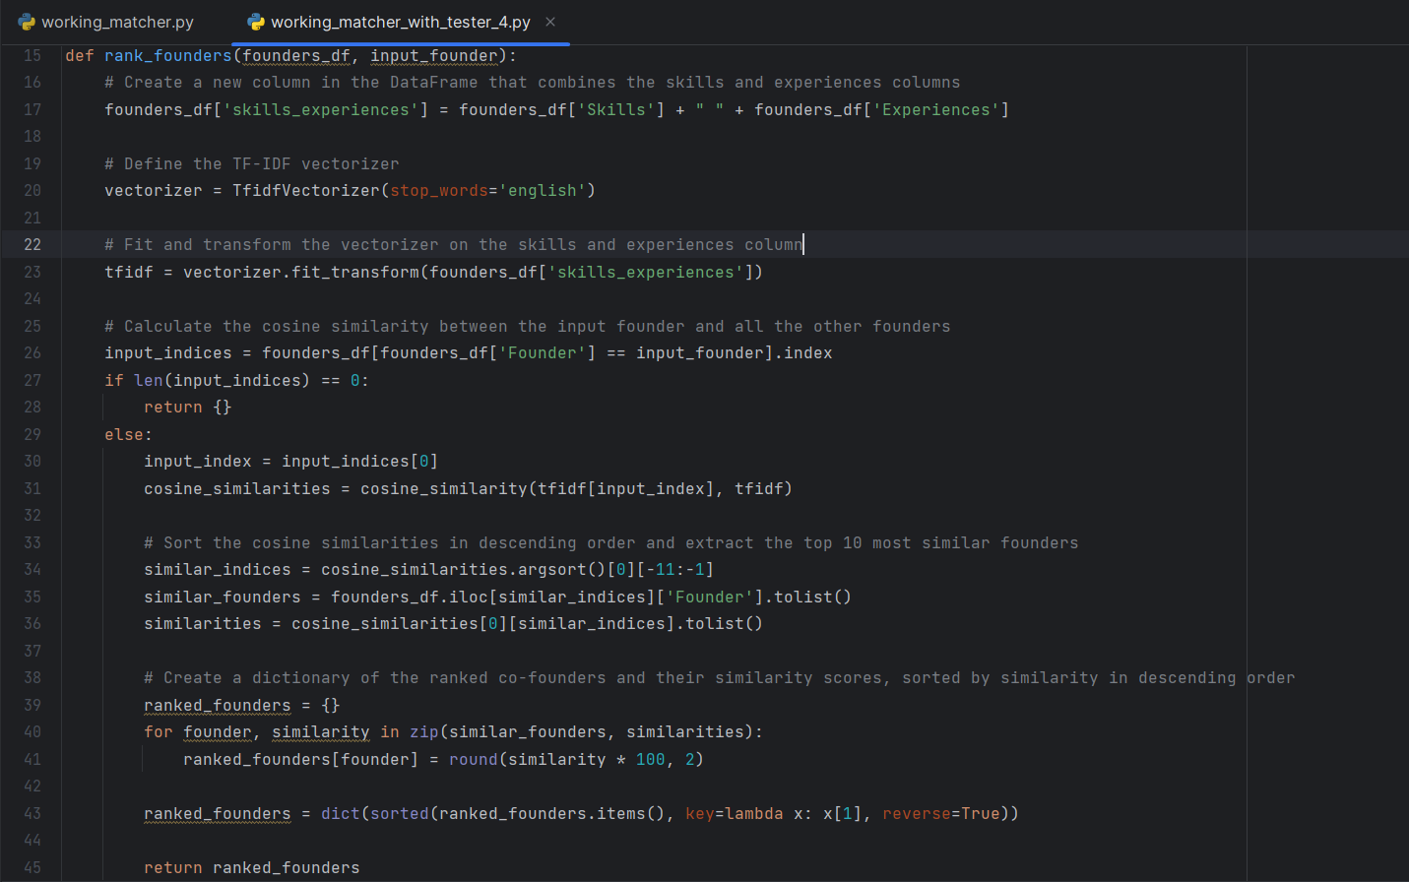

Slide 13

Problems: -Code is %100 ChatGpt made -No evaluation/test for model -Not sure if cosine similarity was the correct pick for the occasion -Can say model pick people with similar skills and experiences.

Slide 14

Thanks for your time, let’s look at the demo

